Slide 1
APPLYING FOR YOUR FIRST REGISTRAR/ DESIGNATED SHO POSITION
www.aucklanddoctors.co.nz/rmos/recruitment

Slide 2

OBJECTIVES
You will understand -
What the annual recruitment cycle is
Timelines for applying
How to prepare your applications
How to strengthen your applications
What we expect in an interview
How selection works
        Ranking
        Highlighting your wins
Summary
Opportunity to ask any questions you may have
www.aucklanddoctors.co.nz/rmos/recruitment
Notes:
First, we’ll run through our objectives for the session,

Slide 3
The Annual Recruitment Cycle (ARC)
November / December 2019 starts plus
      February, April, May, June, August 2020 starts
Annual national process
Set dates for all DHB’s
Standardised selection within Auckland
Applicants must apply and include
      CV (and cover letter for some specialties)
      Certified documents as instructed during the application process
      Upload referee contact details as prescribed on the dedicated reference website
Interview
www.aucklanddoctors.co.nz/rmos/recruitment

Slide 4
The ARC Timeframes
Applications Open
Applications Close
15 April
Final shortlisting for interviews
12 May
Interviews take place
13 May –
24 May
Registrar and designated SHO Offers sent
House Officer offers sent
27 May –
5 July
22 July
Registrar and Designated SHO offers accepted/declined.
House Officer offers accepted/declined
5 August
29 July
12 August
www.aucklanddoctors.co.nz/rmos/recruitment

Slide 5

THE APPLICATION PROCESS
www.aucklanddoctors.co.nz/rmos/recruitment

Slide 6
WHO NEEDS TO APPLY?
You need to apply via the Annual Recruitment Cycle if:
You are a House Officer ready to step up to a designated SHO or Registrar position
You are a Basic Trainee Medicine Registrar applying for Advanced Training
You are wanting sub-specialty exposure or needing a run for dual training purposes as a Medicine Registrar
If you are friends with or know of other House Officers or Registrars outside the Auckland region that you know want to come to our region next year, please ensure they apply
NOTE: If you are a current employee in on-going employment (not on a fixed term contract) and you are unsuccessful in obtaining one of the above positions applied for, then you will remain in your current role.

Slide 7
Q: IF YOU WERE EMPLOYING A HOUSE OFFICER FOR THEIR FIRST JOB, WHAT WOULD YOU LOOK FOR IN AN APPLICATION
Think like an employer
www.aucklanddoctors.co.nz/rmos/recruitment
Notes:
Talk to the person next to you – what would you be looking for? – elicit but not to whiteboard – feedback to front

Slide 8
CONFIRM REFEREES
Contact your referees before uploading them to the Reference website
Add to your CV as above – You need to know this Information in order to upload to our reference website
Relief run? Still required – most recent experience
Back up supervisors
 | Supervisor Name | Supervisor Position/Title | Supervisor Email Address | Supervisor Phone # | Place of work | Dates of supervision
Current run supervisor House Officers: Feb 19- May 19 Registrars: Dec 18 - June 19
1 run prior supervisor House Officers: Nov 18 – Feb 19 Registrars June – Dec 18
2 runs prior supervisor House Officers: Aug 18 – Nov 18 Registrars : Dec 17– June 18
www.aucklanddoctors.co.nz/rmos/recruitment

Slide 9
PREPARING YOUR CV
Required to use the NRA CV template –online
Include:
  Months and years of each position at each employer
  Names and dates of each rotation, including average number of hours per week if you have done part-time or locum work
  Dates and explanation of any gaps
  If on parental leave or leave without pay write which DHB you were employed under at the time
  Include seminars, presentations, audits, courses, etc. relevant to your specialty
  NOTE: Your CV needs to cover all this information for the VTC to be able to make their assessment as to whether to select for interview.
www.aucklanddoctors.co.nz/rmos/recruitment
Notes:
You must use the NRA template as this helps with standardisation of applications. Breaks in employment are required as it may affect your salary calculation.

Slide 10
WRITING A PERSONAL SUMMARY
Stand out from the crowd!
Some specialties require you to write a cover letter as part of your application, so please ensure you do as instructed.
Your CV as per the NRA template requires you to also include a personal Summary.
Regardless: your personal summary and/or Cover letter should:
  Include reasons WHY you are applying
  Tell us WHY you are suitable
  Highlight what additional work / research/audits/presentations/posters you have done to gain further insight into the specialty
  Do not include a story about a patient – this is about YOU
www.aucklanddoctors.co.nz/rmos/recruitment
Notes:
Last year we screened around 1600 applications so we read through a large number of cover letters! Although it won’t necessarily get you the job, it does show the selection committee how committed you are and also give background to your application. Recommendation is – do it and do it well!

Slide 11
CERTIFIED OR SIGHTED
DOCUMENTS THAT WILL BE REQUIRED
Primary medical degree
Photo ID page of passport
  Legal right to work in New Zealand (Visa) if applicable
Drivers Licence
APC (if not registered with MCNZ)
www.aucklanddoctors.co.nz/rmos/recruitment

Slide 12
REQUIREMENTS FOR ALL APPLICANTS
Please be aware that in order to make the recruitment process as simple as possible your complete application will need to be submitted by the closing date of 12 May 2019 to be considered for a position. We are unable to accept any incomplete or late applications.
Your application will be considered complete if:
  you have completed the online application form
  pushed the submit button
  Uploaded all the required documents as instructed.
  We will require all your documents to be clearly named following the filing conventions examples below:-
Surname First Initial - Document name (e.g. Doe J - Passport ; Doe J - CV)

Slide 13
STRENGTHENING YOUR APPLICATION
Decide on your specialty
  Research
  Talk with a relevant Consultants and Registrars
  Observe a team
  Promote yourself and your interest areas
  Read and understand basic requirements of training programme (College websites, discussions)
  Read specialty articles / recent NZ research
  NOTE: have a back-up plan. What is your second choice if you cannot get in to your first choice of specialty?
www.aucklanddoctors.co.nz/rmos/recruitment
Notes:
In addition, you may prepare now before applying by doing any or all of the following things:
Think about how you can stand out!

Slide 14
APPLY!
www.aucklanddoctors.co.nz/joblistings
Between 15 April to 12 May 2019
Applications open strictly for one month. Don’t delay your application!
Only complete applications received before the closing date of 12 May will be considered for positions
Incomplete or late applications will not be accepted
Remember to upload your CV, cover letter if required and certified documents saved in the format as per our website instructions. And know the contact details of the prescribed runs required referees.
NOTE: Hiring managers have full visibility of your application – including when you applied - DON’T LEAVE YOUR APPLICATION TO THE LAST DAY!
STAND OUT FROM THE CROWD
www.aucklanddoctors.co.nz/rmos/recruitment
Notes:
Once you have done all these things you are ready to apply.

Slide 15


PREPARING FOR THE INTERVIEW
www.aucklanddoctors.co.nz/rmos/recruitment
Notes:
Say you have been shortlisted for interview, let’s move on to how to prepare for it.

Slide 16
The ARC Timeline
Final shortlisting for interviews
Interviews take place
Registrar and designated SHO Offers sent
13 May – 24 May
27 May – 5 July
Registrars and designated SHO offers accepted/declined.
House Officer offers sent
22 July
House Officers offers accepted/declined.
29 July
5 August
12 August
www.aucklanddoctors.co.nz/rmos/recruitment
Notes:
Read through…

Slide 17
INTERVIEW PROCESS
If successful in obtaining an interview, you will be sent the link to the specialty interview calendar where you will be required to choose your own interview time-slot.
Please book your time-slot immediately as it will time out and interview time slots are on a first in first serve basis regarding time-slots available.
Check your SPAM/Junk mail box regularly for the interview link email
The majority of interviews are held at the NRA Penrose office. As such the Interview Calendar will include information on where to go for your interview.
Make sure you plan for Auckland traffic and arrive 15 minutes prior to your allotted interview time-slot. So that you can collect your thoughts and give your best during the interview.
www.aucklanddoctors.co.nz/rmos/recruitment
Notes:
Say you have been shortlisted for interview, let’s move on to how to prepare for it.

Slide 18
INTERVIEW PROCESS CONTINUED
You will be expected to do a face to face interview. Only under exceptional circumstances can telephone/zoom interviews be facilitated.
If you do require a phone/zoom interview you will need to inform your Recruitment & Allocations Consultant as soon as you have booked your time-slot via the interview link email.
You will need to inform your Recruitment & Allocations Consultant in writing along with the full telephone number on where you can be reached on interview day or your zoom account confirmation.
Panel consists of a minimum of 2 consultants and 1 NRA representative. The interview can vary between 20 minutes to an hour depending on specialty and RMO level
Recruitment & Allocations Consultant will advise if successful via email on National Offer Day
Due to the high numbers, unfortunately there will be no individual feedback.

Slide 19
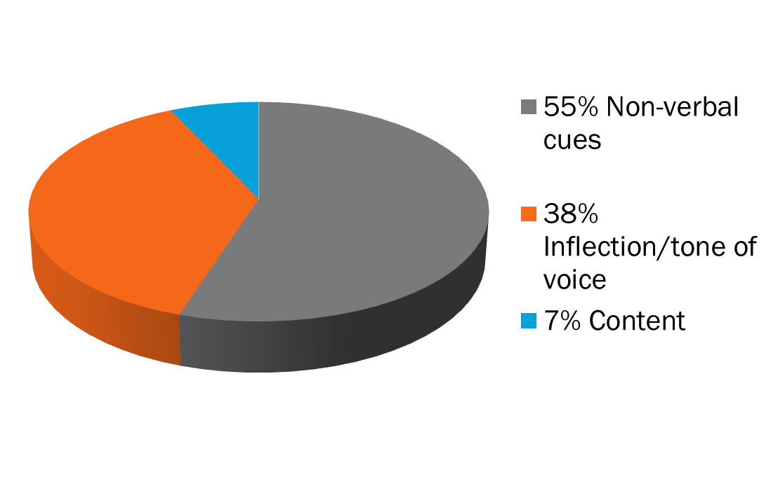
FIRST IMPRESSSIONS COUNT
www.aucklanddoctors.co.nz/rmos/recruitment
Notes:
You either make/break it in the first 30 Secs!

Slide 20
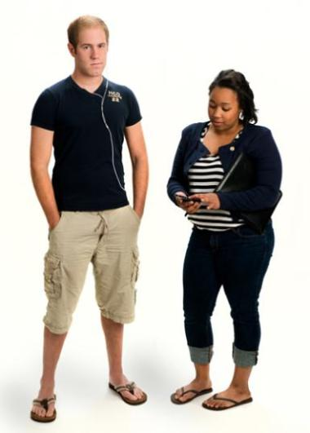

PRESENTATION
www.aucklanddoctors.co.nz/rmos/recruitment
Notes:
Dress for Success

Slide 21
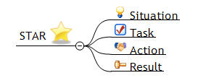
BEHAVIOURAL INTERVIEWS
  Common behavioural interview topics:
    Teamwork
    Leadership
    Handling Conflict
    Problem Solving
  Answer using STAR method
www.aucklanddoctors.co.nz/rmos/recruitment
Notes:
Want to see – reflection… what you have learnt through this.

Slide 22
SELECTION
Preference NZ citizens/ Permanent residents and graduates
Specialty Ranking Process
    Application score (CV, cover letter etc.)
    Reference scores
    Interview scores
www.aucklanddoctors.co.nz/rmos/recruitment

Slide 23
ONBOARDING PROCESS IF YOU ARE SUCCESSFUL
What you need to start on Day 1:
  A valid Practicing Certificate
  The legal right to work in New Zealand
  Police Checks provided and completed as per VCA legislative requirements
  Pre-employment Health Screening clearance
  Valid ACLS/APLS
  Indemnity Insurance
  Payroll Documentation
If you are coming from overseas, the Recruitment & Allocations Coordinators will assist with the process
www.aucklanddoctors.co.nz/rmos/recruitment
Notes:
Role play!

Slide 24
SUMMARY
The Annual Recruitment Cycle commences shortly
Prepare, prepare, prepare
Begin writing CV, cover letter, contacting referees
Strengthen application by researching / making contacts in the specialty
Think of alternative specialties
Prepare for interview – research common questions, think of good examples
Practice, practice, practice
www.aucklanddoctors.co.nz/rmos/recruitment

Slide 25

QUESTIONS
www.aucklanddoctors.co.nz/rmos/recruitment

